Slide 1

Iconography IT 467

Slide 2
Today’s Topics
Logo vs. Icon
Mistakes in Icon Design

Slide 3
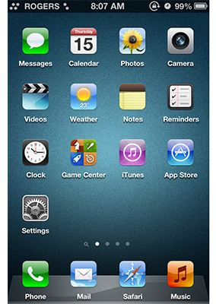
The benefits of icons in a graphical user interface
Icons make good targets: they are typically sized large enough to be easily touched in a finger-operated UI, but also work well with a mouse cursor (in contrast to words, which can suffer from read–tap asymmetry on touch screens).
Yet they save space: icons can be compact enough to allow toolbars, palettes, and so on to display many icons in a relatively small space.
Icons are fast to recognize at a glance (if well designed) — particularly true for standard icons that people have seen and used before.
https://www.nngroup.com/articles/icon-usability/
Notes:
read–tap asymmetry, where text big enough to read is too small to touch.

Slide 4
The benefits of icons in a graphical user interface
There is no need to translate icons for international users, provided that the icons are mindful of cultural differences. (for example, mailboxes look very different in various countries whereas envelopes look the same, therefore an envelope is a more international icon for an email program than a mailbox).
Icons can be visually pleasing and enhance the aesthetic appeal of a design.
They support the notion of a product family or suite when the same icons and style are used in several places.

Slide 5
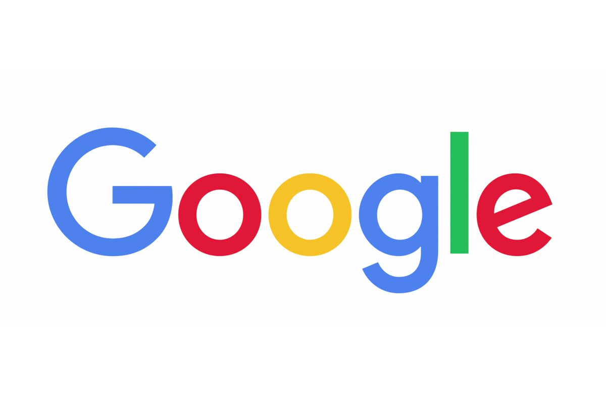
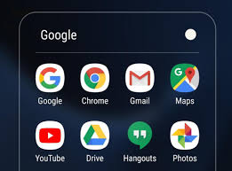
Logo vs. Icon
Notes:
Shape: A logo could be any shape, color or dimension; it can be used on a 100 meters banner It’s only constraint is that of the physical media that will display it.
https://medium.com/@subsign/logo-vs-icon-c2ad6eaab980#:~:text=Shape%3A%20Icons%20are%20made%20to,16x16%20(favicon)or%20512x512.

Slide 6
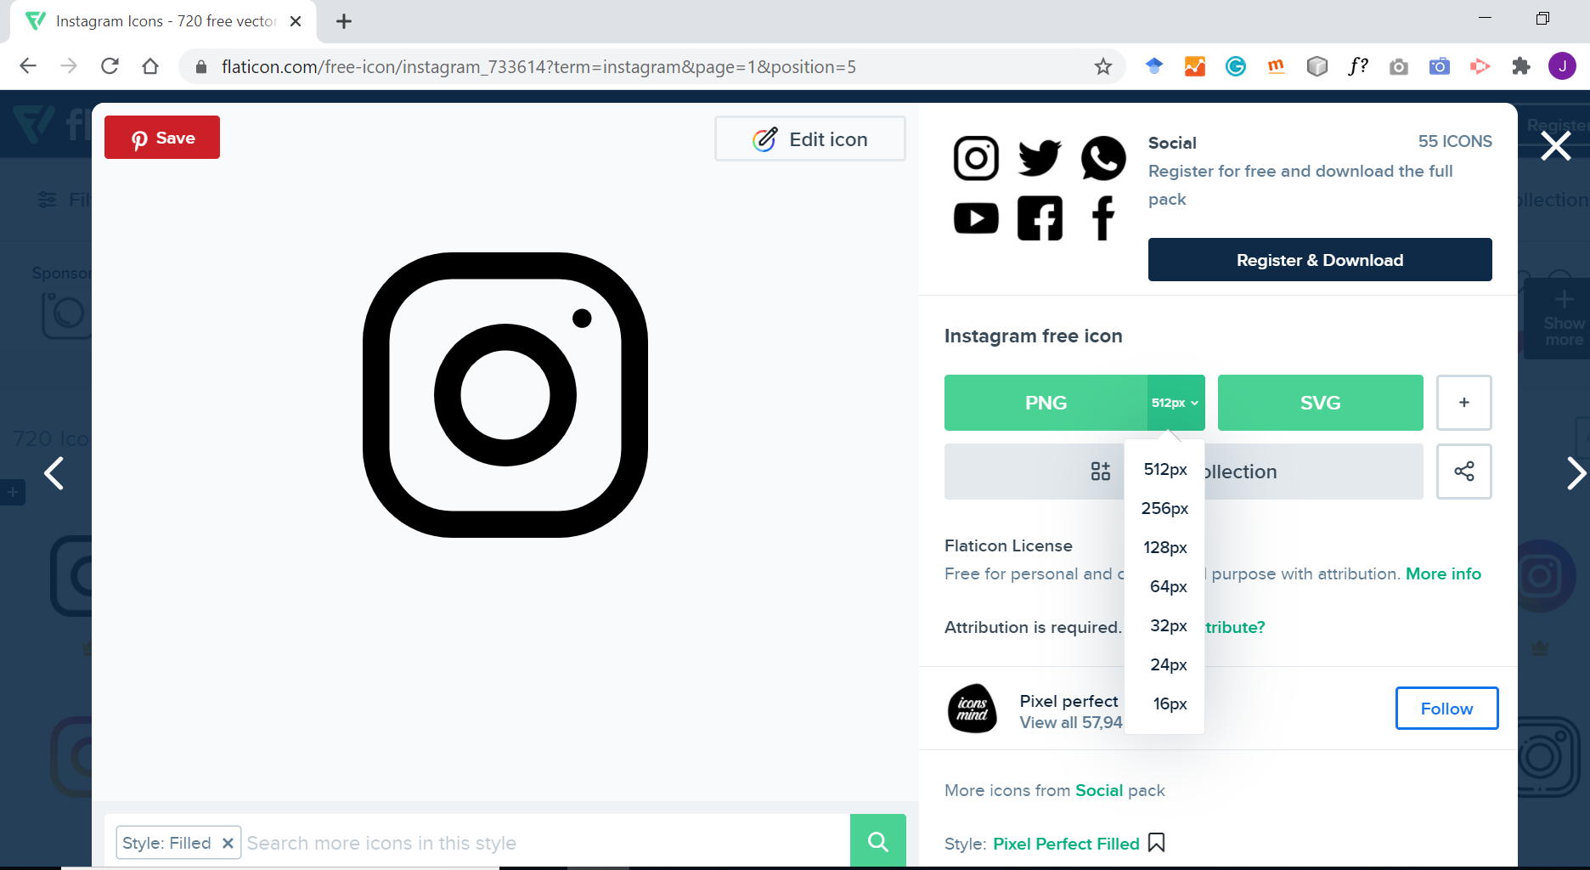
Icons are visual descriptors
Visual metaphor to convey the primary function of the application or the object.
Shape: fit in squares (‘quadratic’)
Size: 16x16 (favicon) - 512x512
https://fonts.google.com/icons
https://www.flaticon.com/
Notes:
What is favicon?
Now there are icons 1024x1024

Slide 7
Google play icon requirements
Final size: 512px x 512px
Format: 32-bit PNG
Color space: sRGB
Max file size: 1024KB
Shape: Full square – Google Play dynamically handles masking. Radius will be equivalent to 20% of icon size.
Shadow: None – Google Play dynamically handles shadows. See 'Shadows' section below on including shadows within your artwork.
https://developer.android.com/distribute/google-play/resources/icon-design-specifications

Slide 8
Apple’s icon requirements
All app icons should adhere to the following specifications.
Attribute | Value
Format | PNG
Color space | Display P3 (wide-gamut color), sRGB (color), or Gray Gamma 2.2 (grayscale). See Color Management.
Layers | Flattened with no transparency
Resolution | Varies. See Image Size and Resolution.
Shape | Square with no rounded corners
https://developer.apple.com/design/human-interface-guidelines/ios/icons-and-images/app-icon/

Slide 9
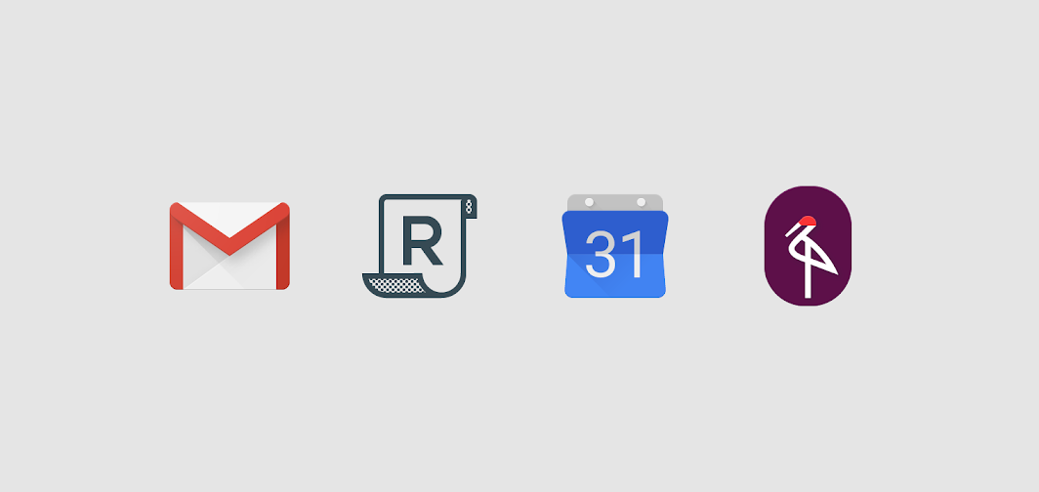
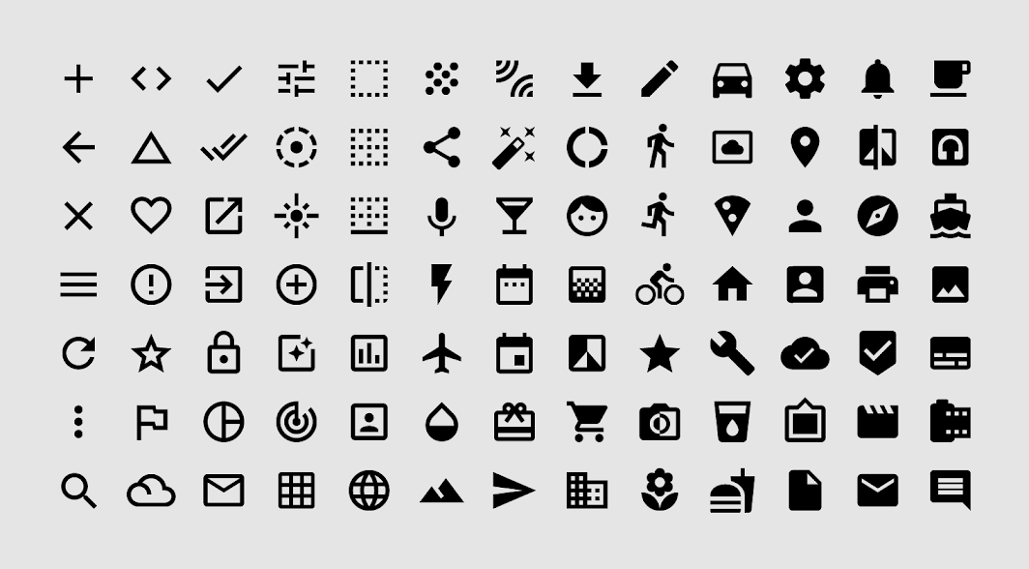
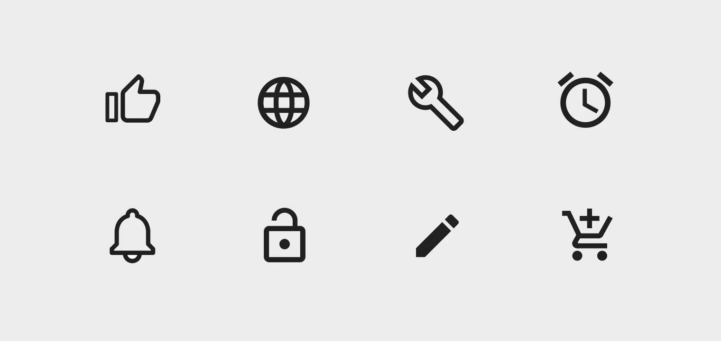
Different types of icons
Product icons
System icons
Animated icons
Notes:
https://material.io/design/iconography/product-icons.html
https://material.io/design/iconography/animated-icons.html#transitions

Slide 10
Mistakes in Icon Design
http://turbomilk.com/blog/cookbook/icon_design/10_mistakes_in_icon_design/

Slide 11
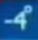

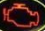

Slide 12
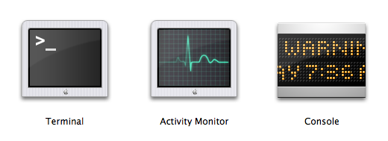
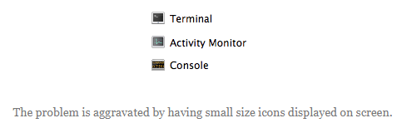
Insufficient differentiation between icons

Slide 13
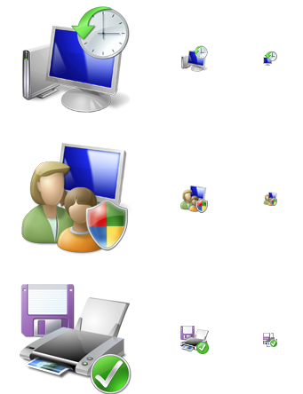
Too many elements in one icon

Slide 14
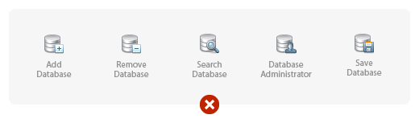
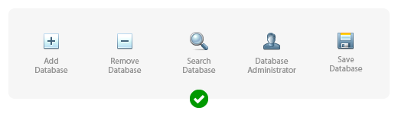
Unnecessary elements

Slide 15
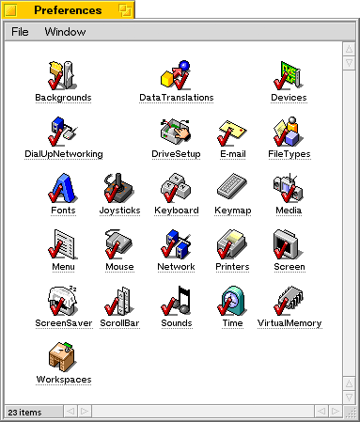
BeOS 5 icons example
Notes:
Ticks here are absolutely superfluous. By the way, why are they done in red?

Slide 16
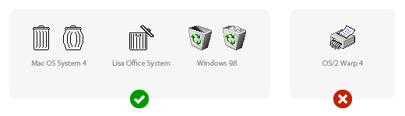
Overly original metaphors
Another problem with choosing a shredder is that there is no one well-known type of shredder out there. The icon appears very much like a printer with an octopus hidden inside. What is more, it is absolutely unclear how a full bin would be displayed according to this metaphor.

Slide 17
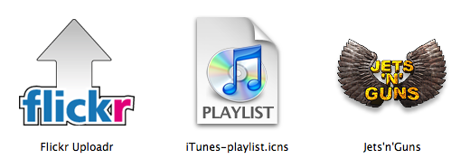
Text inside icons
Firstly, it is directly language-related and so impedes localization.
Secondly, if the icon is small, it is impossible to read the text.
Thirdly, in the case of application icons, this text is repeated in the name of the application
Notes:
http://turbomilk.com/blog/cookbook/icon_design/10_mistakes_in_icon_design/

Slide 18



Slide 19
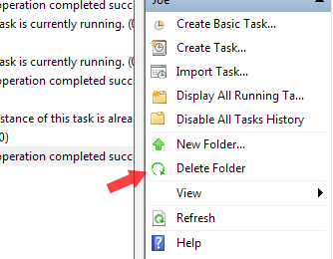
Inaccurate icon image

Slide 20
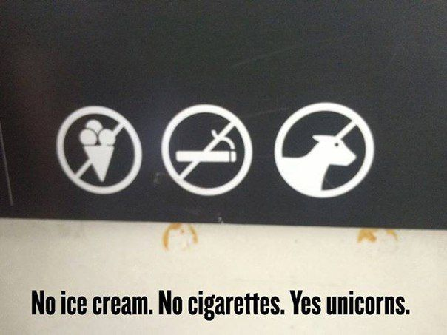
https://blog.icondesignlab.com/en/2018/10-mistakes-in-icon-design-that-confuse-users/

Slide 21
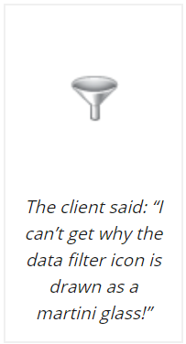

https://blog.icondesignlab.com/en/2018/10-mistakes-in-icon-design-that-confuse-users/

Slide 22
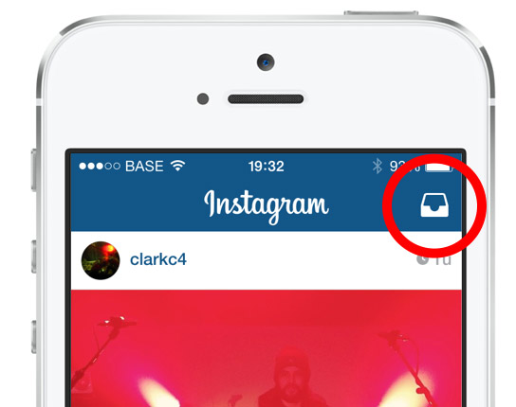

The paper-box icon was unclear to the user; only a few people understood that they were supposed to send private messages by clicking on it.

Slide 23

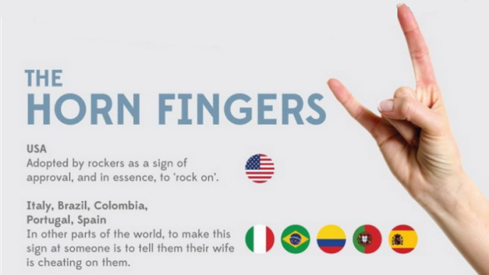
Not taking into account the cultural characteristics of your target audience
https://blog.icondesignlab.com/en/2018/10-mistakes-in-icon-design-that-confuse-users/
https://en.wikipedia.org/wiki/Sign_of_the_horns#:~:text=The%20sign%20of%20the%20horns%20is%20a%20hand%20gesture%20with,fingers%20down%20with%20the%20thumb.

Slide 24

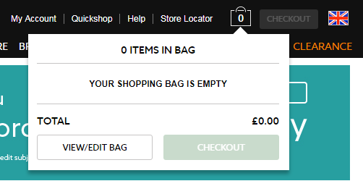
The United Kingdom residents are more familiar with a bag or a basket icon.

Slide 25


Icon Classification: Resemblance, Reference, and Arbitrary Icons
Resemblance Icons: Depicting a physical object which the icon is intended to represent. Using a picture of an envelope to represent a file of electronic mail would be a resemblance icon.
https://www.nngroup.com/articles/classifying-icons/
Notes:
NN group divided icons into three groups.
floppy disk

Slide 26
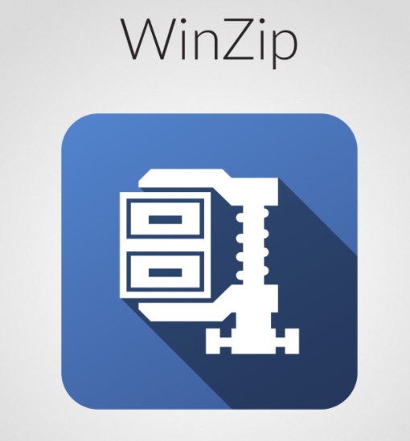

Icon Classification: Resemblance, Reference, and Arbitrary Icons
Reference Icons: Depicting some object which by reference or analogy might represent the concept the icon is intended to represent. For example, using a picture of a clamp to represent a file-compression utility (because it squeezes) would be a reference icon.

Slide 27

Icon Classification: Resemblance, Reference, and Arbitrary Icons
Arbitrary Icons: Arbitrary shapes that only have meaning by convention. Traffic signs are often arbitrary icons and may form a good source of computer icons because of their fairly standardized international use. For example, a warning triangle might be used as the icon for a warning message.

Slide 28

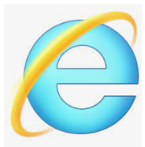
Bad Icons: How to Identify and Improve Them
The visual already has a different, established meaning.
A star icon, for example is for rating and bookmarking, not to view “presentation templates.”
The Internet Explorer icon means “launch Internet Explorer,” not “open a list of web links.
https://www.nngroup.com/articles/bad-icons/

Slide 29
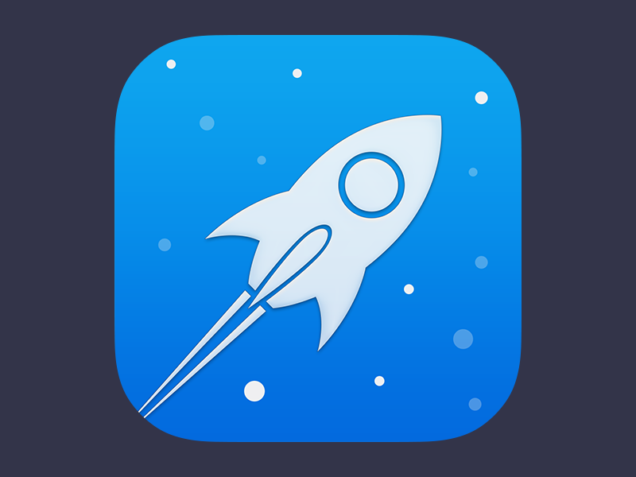

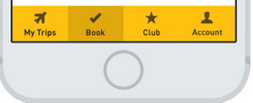
Bad Icons: How to Identify and Improve Them
The reference is too esoteric and requires too many inferences.
An image of a rocket may lead the occasional user to make the leap from “rocket” to “launch” to “app”, as in launch applications.
https://www.nngroup.com/articles/bad-icons/

Slide 30

Bad Icons: How to Identify and Improve Them
The icons only work as a set. Users should not have to study all icons in a set to determine the meaning of an individual icon.
Examples of intranet icons: without their labels, can you tell what each one is for?

Slide 31
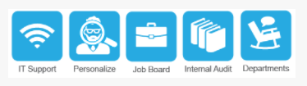
Examples of intranet icons that are not helpful (from left to right):
the ubiquitous wireless symbol used here to represent support,
a hard-to decipher image of a person with a magnifying glass over his face to represent personalization,
a briefcase standing for job listings, books to represent internal audit,
and a chair with a speech bubble to represent departments.
https://www.nngroup.com/articles/bad-icons/
Notes:
nngroup: Examples of intranet icons that are not helpful (from left to right): the ubiquitous wireless symbol used here to represent support, a hard-to decipher image of a person with a magnifying glass over his face to represent personalization, a briefcase standing for job listings, books to represent internal audit, and a chair with a speech bubble to represent departments. (To maintain anonymity of the organization who created these icons, we recreated them in different colors and slightly different styles, but the concepts are the same as the originals.)

Slide 32
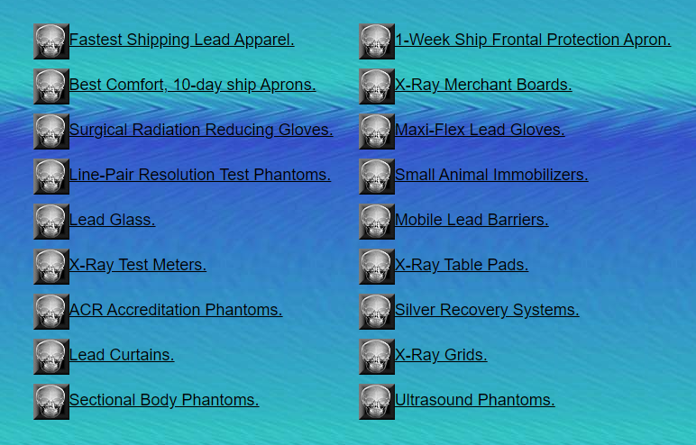
Bad Icons: How to Identify and Improve Them
The icon is repeated for every item in a list.
http://www.pnwx.com/

Slide 33
Icon Usability
https://www.youtube.com/watch?v=ZF_25i-be8k&t=5s

Slide 34
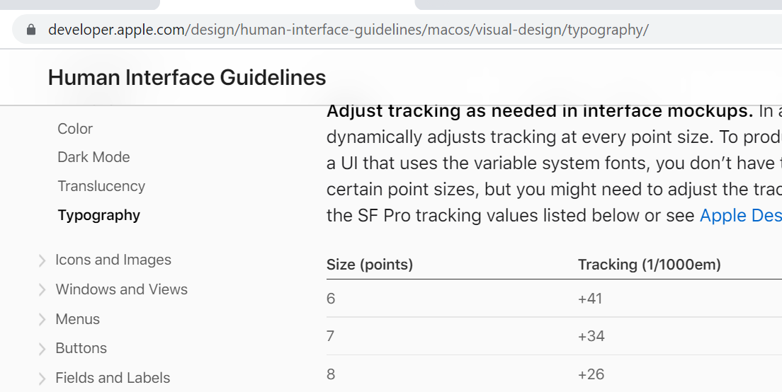
Design guidelines
Google
https://material.io/design/iconography/system-icons.html
Apple
https://developer.apple.com/design/human-interface-guidelines/macos/icons-and-images/app-icon/
Google vs Apple
https://www.appschopper.com/blog/google-material-design-apple-human-interface-guidelines-which-is-better-and-why/
https://uxdesign.cc/7-principles-of-icon-design-e7187539e4a2
Notes:
https://developer.apple.com/design/

